Slide 1
Credit card fraud
By:
Cody Lerch, Debasis Pradhan, Elena Gehle, Isaac Fonseca, and Warren Simmons

Slide 2

Analysis report of credit card fraud
Introduction
This report presents an analysis of credit card fraud. Currently, 60% of U.S. credit card holders have been hit by fraud, and almost half of them multiple times. Last year alone, 52 million Americans dealt with fraudulent charges adding up to over $5 billion. The median amount for a fraudulent charge has jumped 26% in the past two years, going from $79 to $100. Only 7% of these fraudulent charges involve physically stolen or lost cards—the rest are from accessing personal data and account info remotely. And it doesn't help that most cardholders engage in risky behaviors that make their accounts more vulnerable. The thing that stands out is how prevalent online fraud is compared to traditional card theft. Only 7% of fraudulent charges come from physically stolen or lost cards. The remaining 93%? Those are remote attacks on personal data and account info. It’s like a silent thief slipping through your digital door. Today it is known that four out of five cardholders admitting to it means a huge number of people are inadvertently making themselves targets.

Slide 3
Cleaning procedure

Slide 4
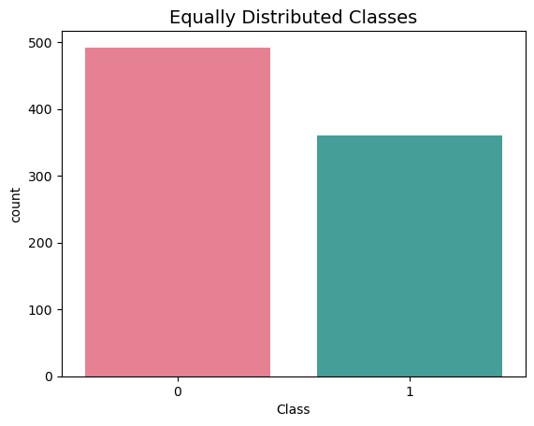
distribution of sub sample classes
0 0.577465
1 0.422535

Slide 5
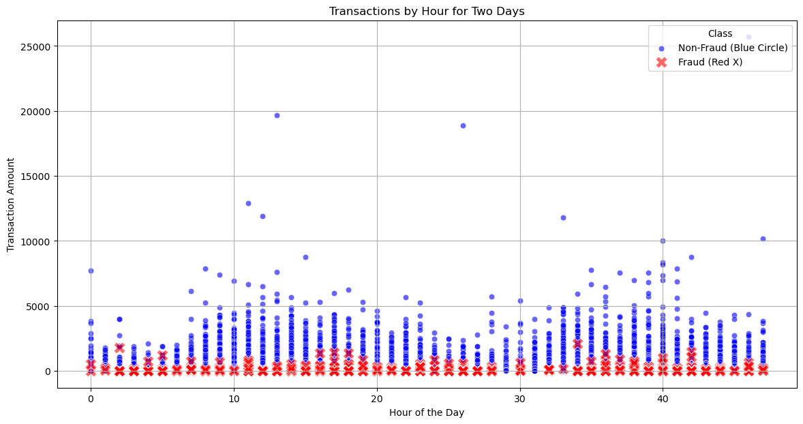
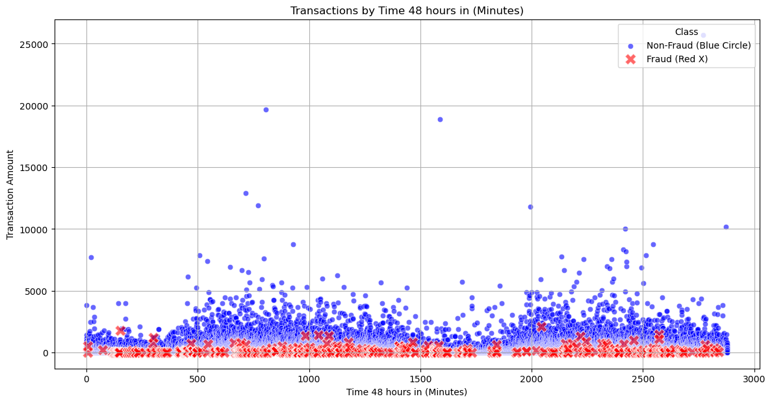
scatter plot by hour and minute

Slide 6
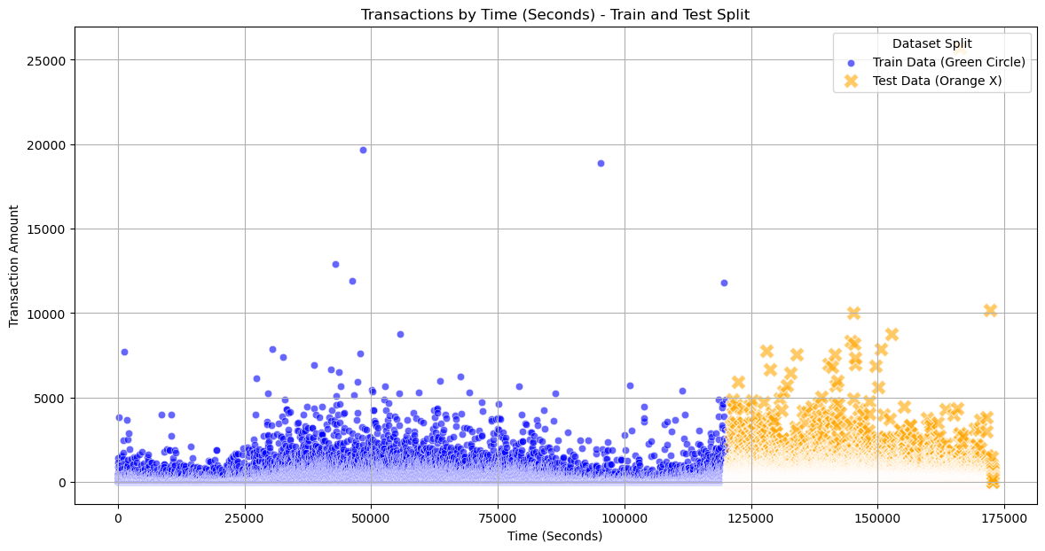
train and test split

Slide 7
Predictive Models considered
Logistic Regression
Decision Tree: DecisionTreeClassifier

Slide 8
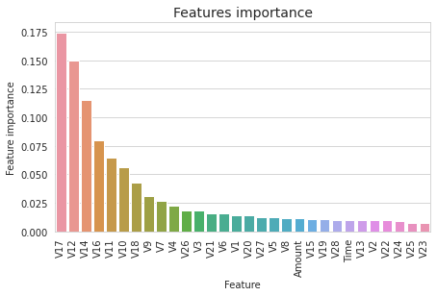
Predictive Models considered
Random Forest: RandomForestClassifier
Gradient Boosting: GradientBoostingClassifier

Slide 9
Predictive Models considered
Support Vector Machine: SVC
ExtraTreesClassifier:

Slide 10
Predictive Models considered
KNN: KNeighborsClassifier

Slide 11
Credit card fraud Trends

Slide 12
Executive Summary

Slide 13
references
1). Gabriel Preda (2024) Credit Card Fraud Detection Predictive Models. https://www.kaggle.com/code/gpreda/credit-card-fraud-detection-predictive-models
2). Brett Cruz(2024, Jul 26) 52 Million Americans Experienced Credit Card Fraud Last Year. Securiety.org
3). RandomForrestClassifier, http://scikit-learn.org/stable/modules/generated/sklearn.ensemble.RandomForestClassifier.html

